Slide 1


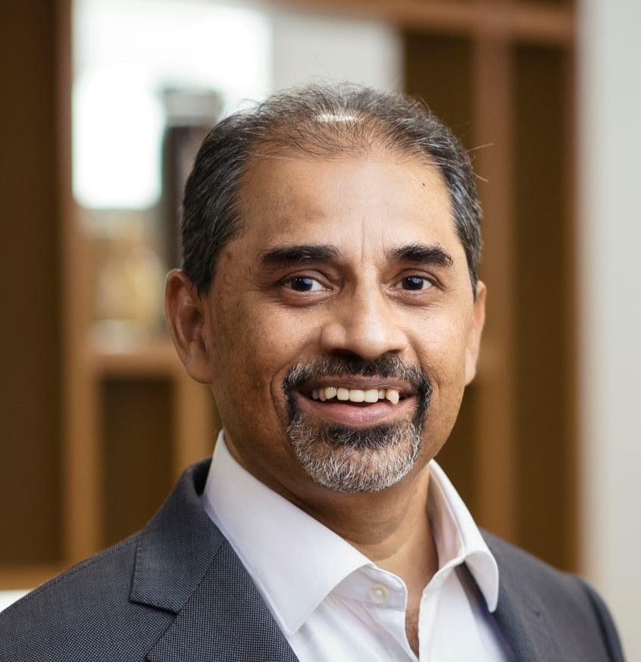
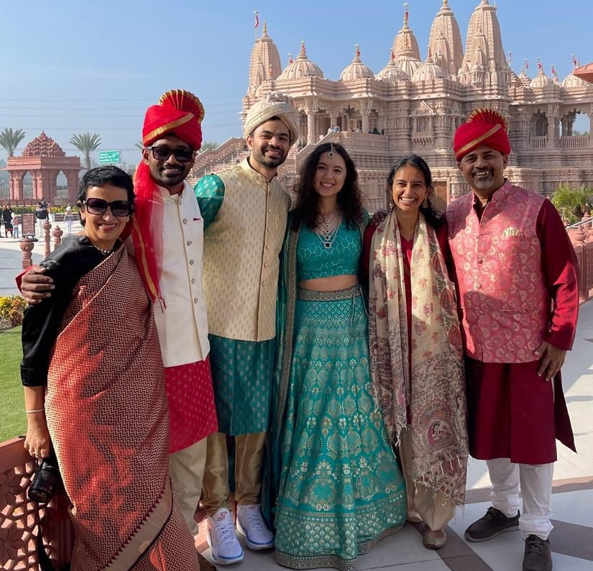
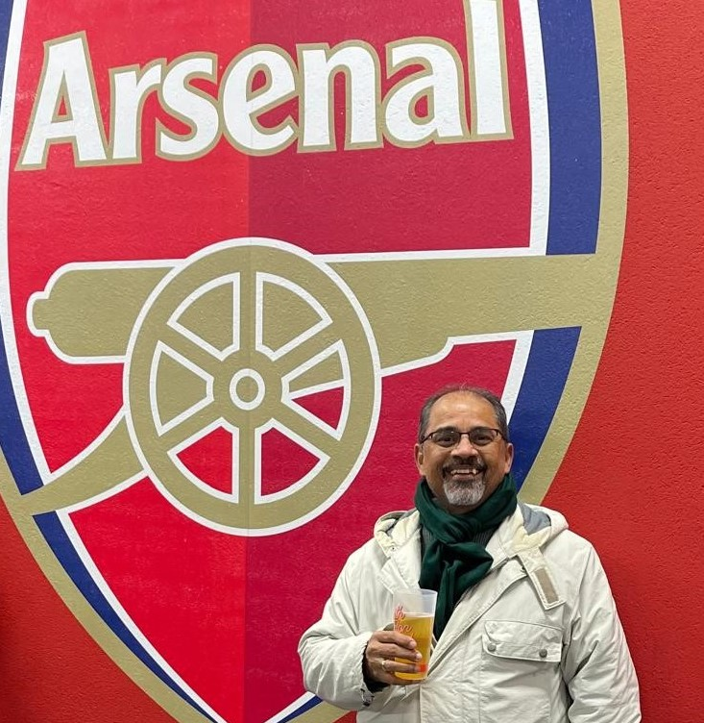
Getting to Know Me
Work
Personal
My role
CEO
Significant others / family members / furry friends in my life
My long suffering wife Ruby and 2 crazy kids Rushika & Iishaan
Tenure in ofi/Olam
34 years
How enjoy spending my free time
I enjoy hiking, spending time outdoors and I love watching sports
Previous companies I have worked at
TSRF, Xerox Corp
My favorite / comfort food
Yellow daal with potato and paneer (homemade is best!)
Why I joined ofi/Olam and what keeps me here?
….Adventure…..many more Adventures…
My favorite song
Even the Nights Are Better – Air Supply
Shekhar A
‘Shekhar’
A few fun facts about me I’m adventurous to try any food or cuisine. My contribution to “Good Food and an (un) healthy future”
This is me outside work, doing stuff I enjoy in my life …

Slide 2
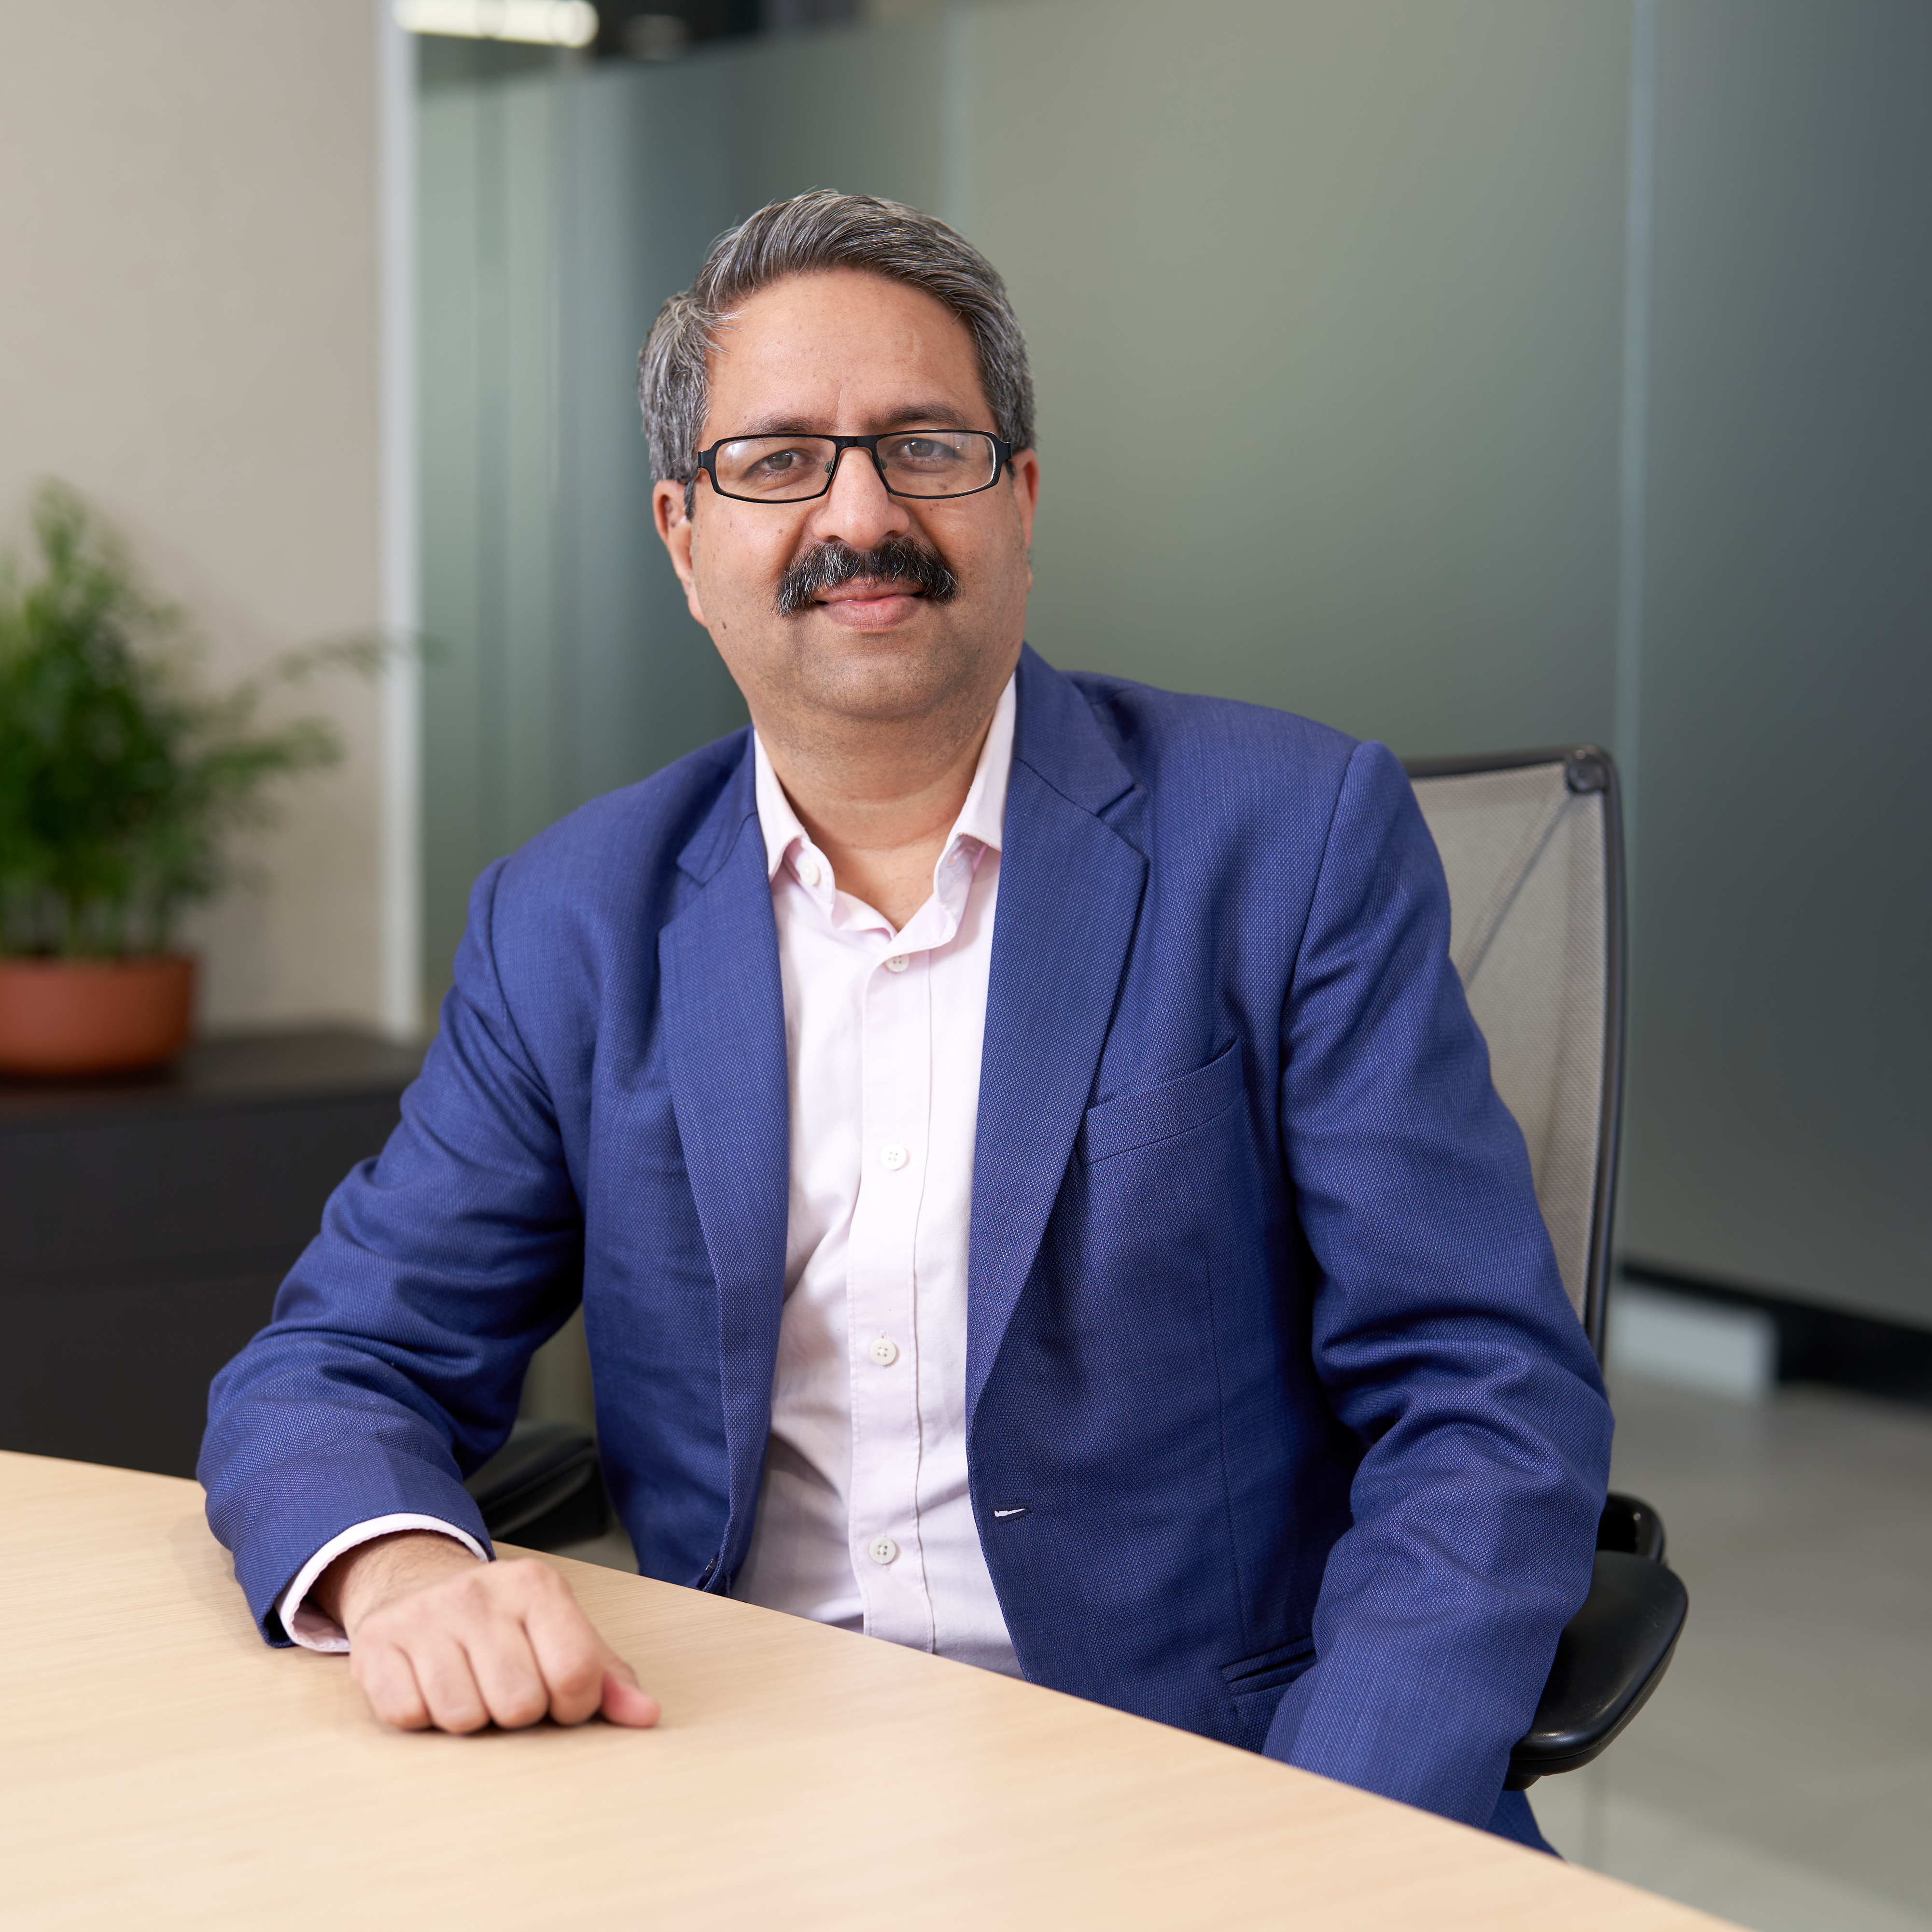
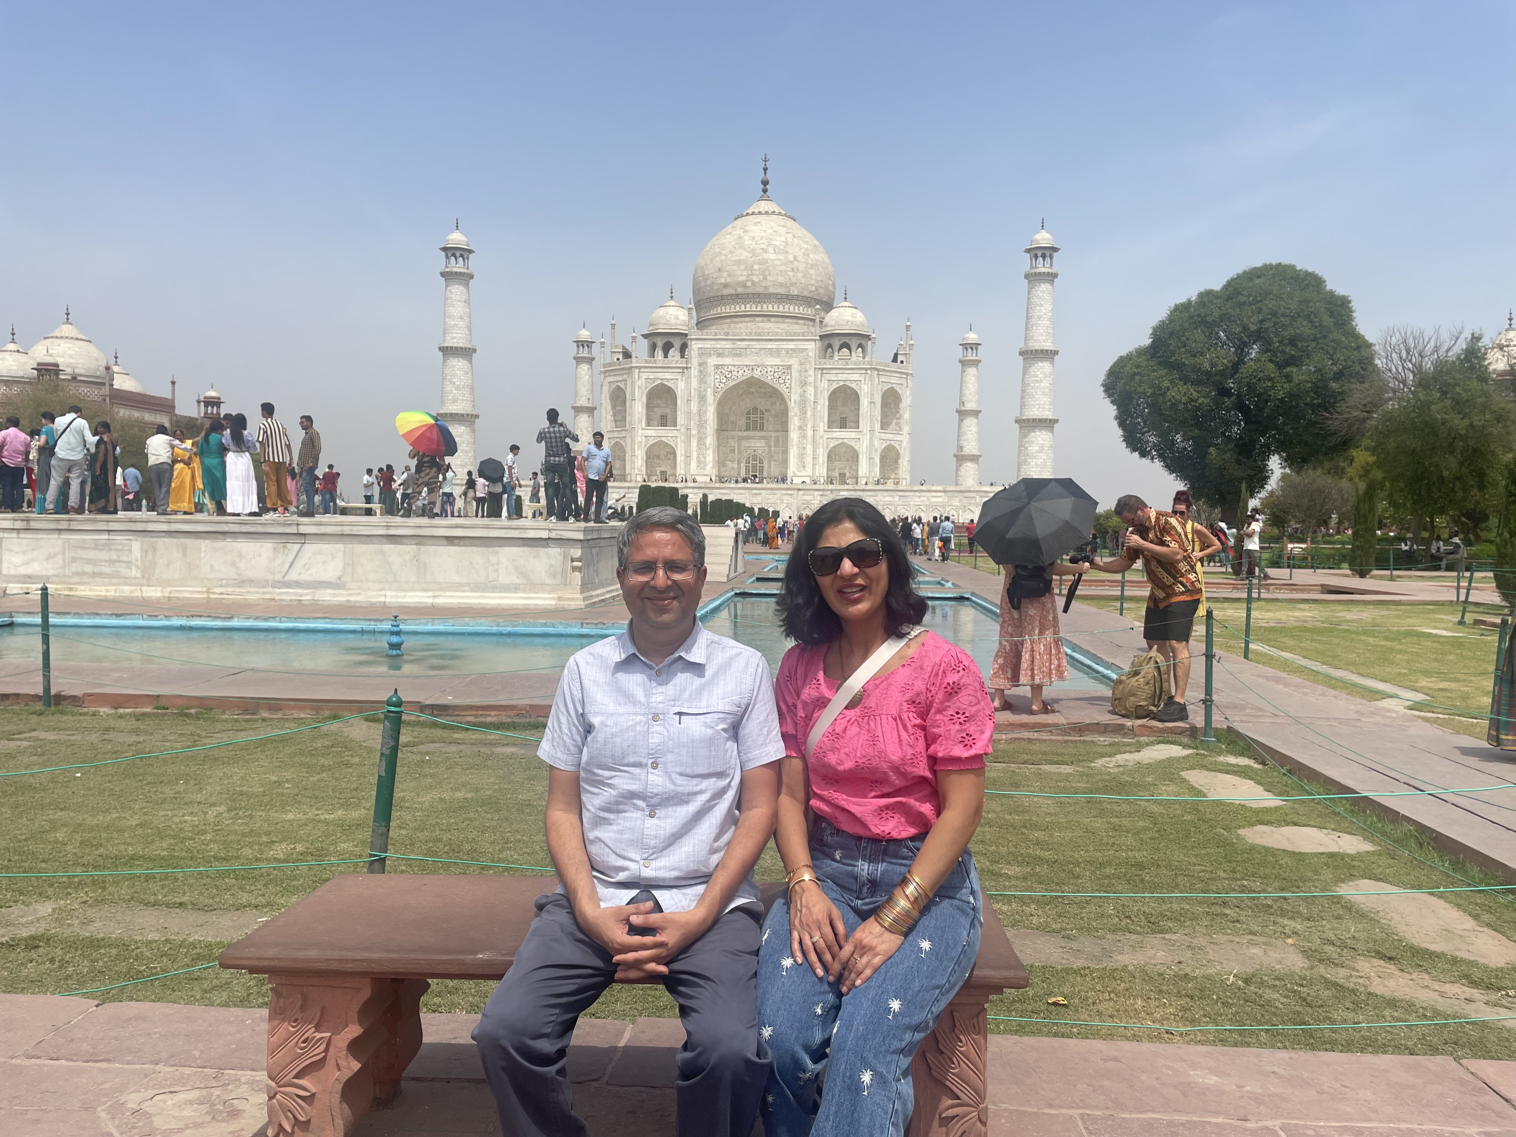
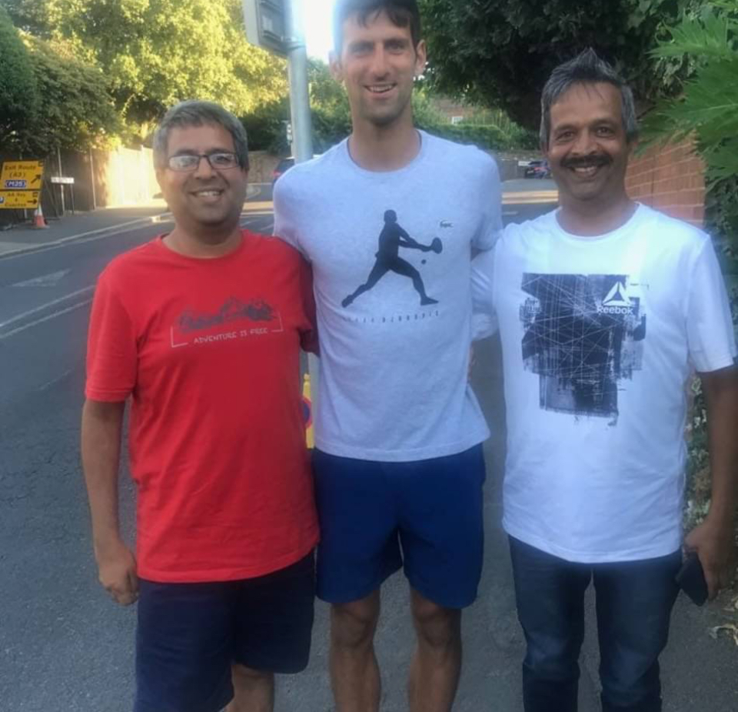
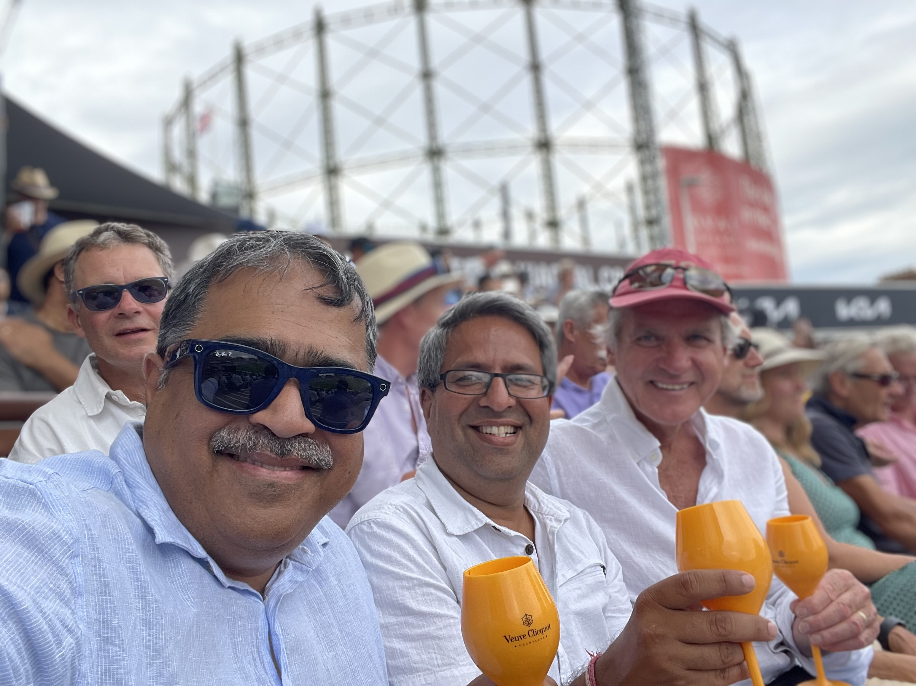
Getting to Know Me
Work
Personal
My role
COO, Cocoa, Regional Head Africa
Significant others / family members / furry friends in my life
My wife and my balance portfolio: Daughter and son
Tenure in ofi/Olam
24
How I enjoy spending my free time
Netflix, following cricket and politics
Previous companies I have worked at
Amul (GCMMF)
My favorite / comfort food
Paneer Tikka and Black Dal!
Why I joined ofi/Olam and what keeps me here?
My favorite song
Ek Ladki Ko Dekha . . . 1942 A Love Story
Manoj Vashista
‘Manoj’
I had joined for financial security with a target for 3 years. People around me keeps me going!
A few fun facts about me
I played female dancer role in a one act play in inter university competition which we won!
This is me outside work, doing stuff I enjoy in my life …

Slide 3
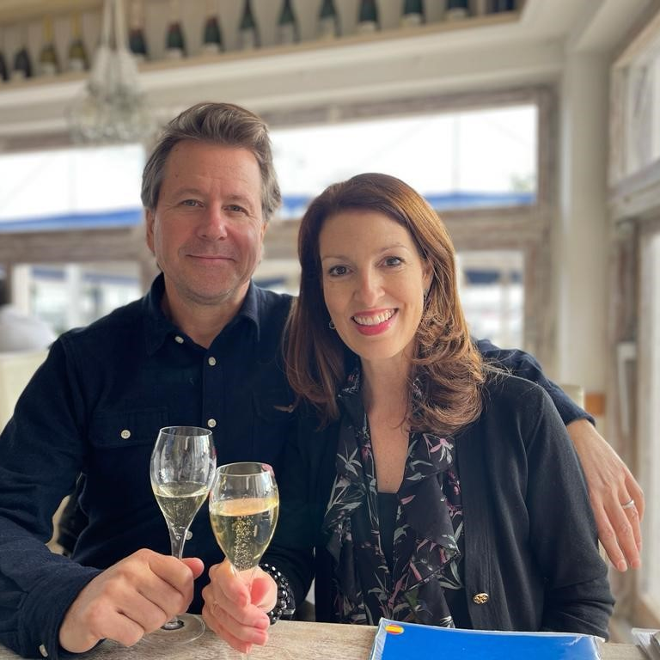
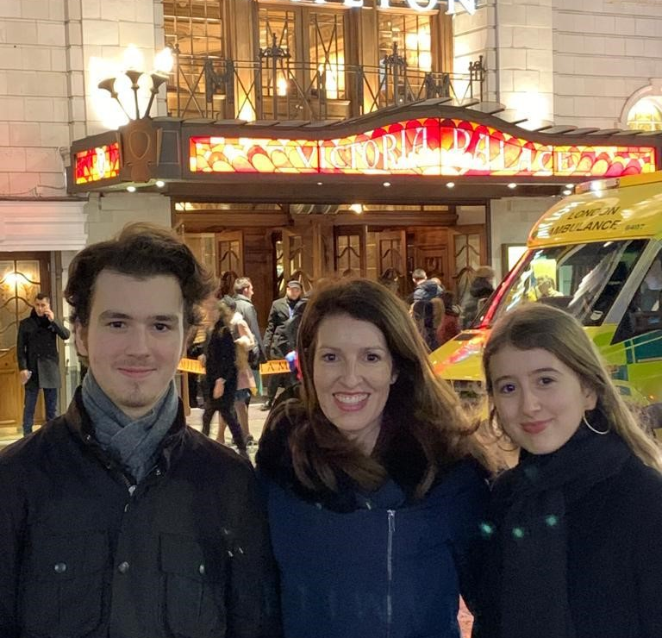
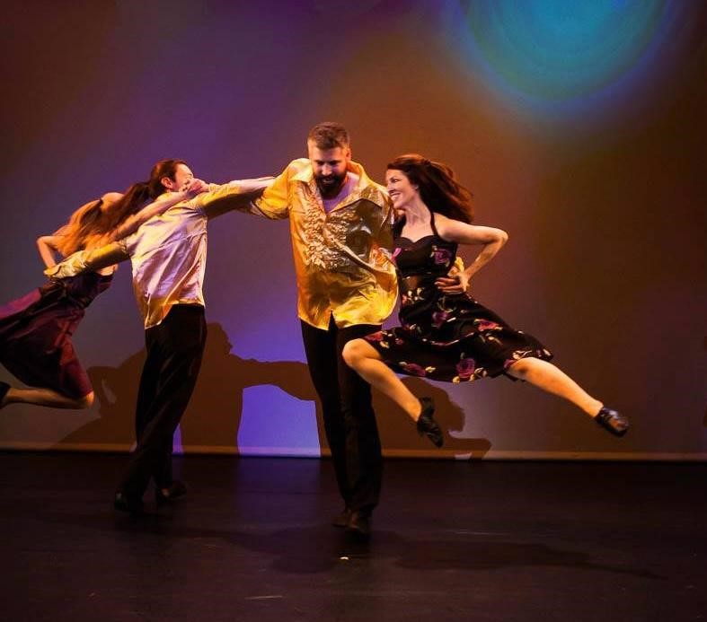
Getting to Know Me
Work
Personal
My role
Global Head of Talent, Learning & IDE
Significant others / family members / furry friends in my life
Husband Bryce, son Aidan, daughter Quin, dog Batman, my mom
Tenure in ofi/Olam
20 months
How I enjoy spending my free time
Dancing, reading, family, home in Spain, travelling
Previous companies I have worked at
The Home Depot, Coca-Cola, Bristol-Myers Squibb, Philips, Avon, Currys
My favorite / comfort food
My husband’s spaghetti bolognese
Why I joined ofi/Olam and what keeps me here?
I joined for the compelling ofi story and to be part of an exciting journey. What keeps me here is the difference we can individually and collectively make
My favorite song
Wavin’ Flag by K’naan
Melissa Hungerford
‘Melissa’
A few fun facts about me
I am in a Dance company
I performed at Sadler’s Wells
I am Colombian American
I started my career as a psychologist
I worked in a prison
My husband and I fulfilled a lifelong dream of buying a home in Spain
This is me outside work, doing stuff I enjoy in my life …

Slide 4
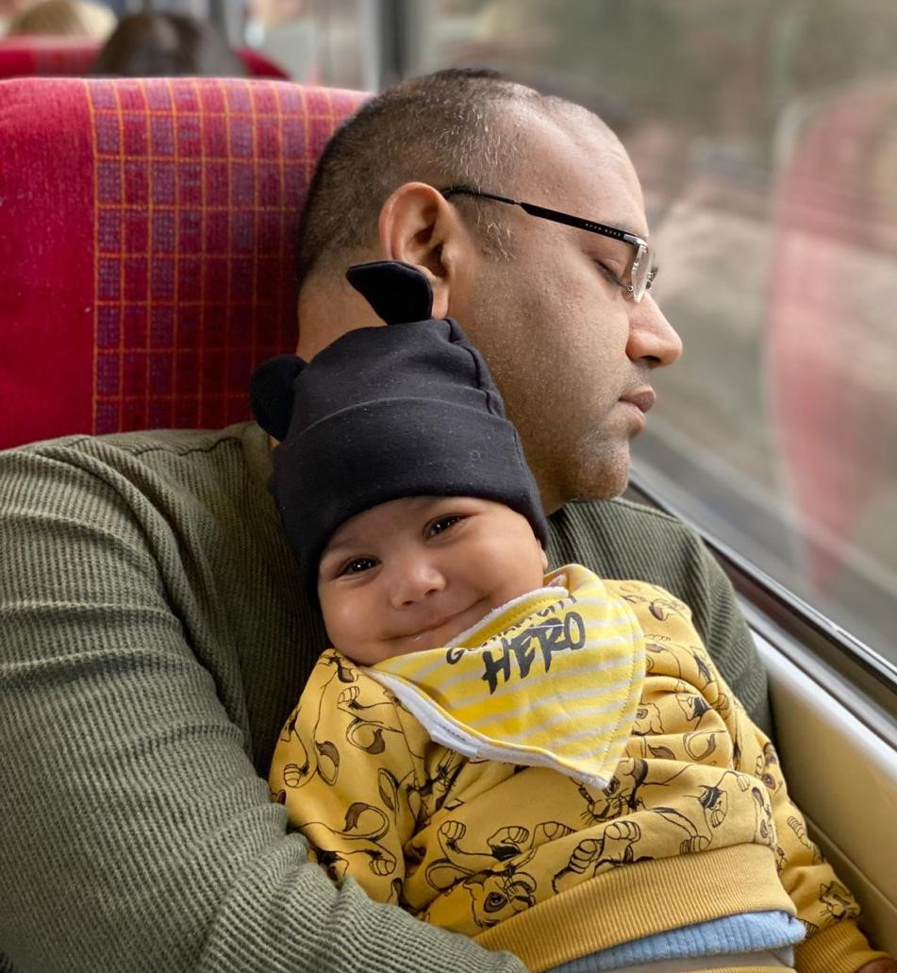
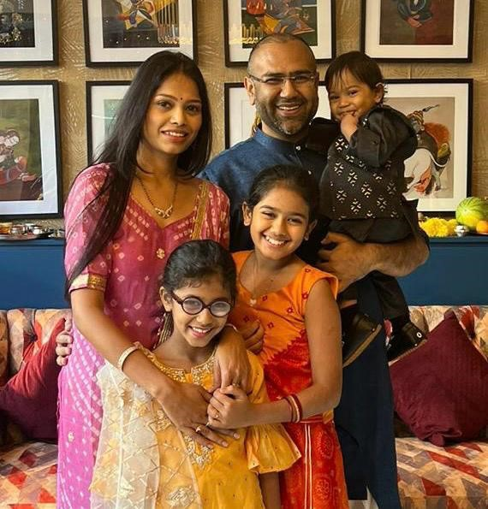

Getting to Know Me
Work
Personal
My role - Blessed to be the captain of a wonderful and excellent team and batting for Cocoa’s profitable innings while bowling tight overs of Africa finance on other hand.
CFO – Cocoa Beans Vertical and Cocoa Sustainability// Africa
Significant others / family members / furry friends in my life
My parents serve as my north star, a stellar wife who keeps me steady, three lively kids who have enough energy to melt the glaciers, and globe-spanning friends who outshine any deal — no pets, unless my ‘macbook’ counts
Tenure in ofi/Olam
Managing all of above for ‘quick’ 18 years while keeping the scoreboard ticking with precision numbers.
How enjoy spending my free time
What’s free time ?
Previous companies I have worked at
Had an interesting introduction to capital markets with Sharekhan at India.
My favorite / comfort food
Anything – well done and spicy hot..
Why I joined ofi/Olam and what keeps me here?
It began with a challenge to join Olam and the constant learning and challenges; excellent colleagues and a great vision kept me here.
My favorite song
In the End – Linkin Park
Rahul Rastogi
‘Rahul’
A few fun facts about me
Focused
Understanding of
Nonsense
This is me outside work, doing stuff I enjoy in my life …

Slide 5
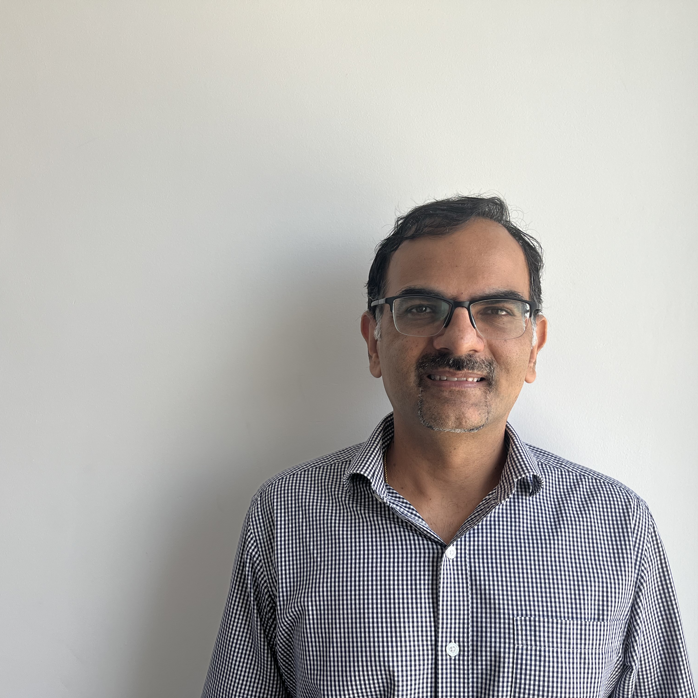
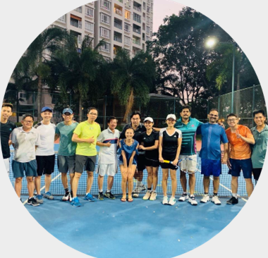
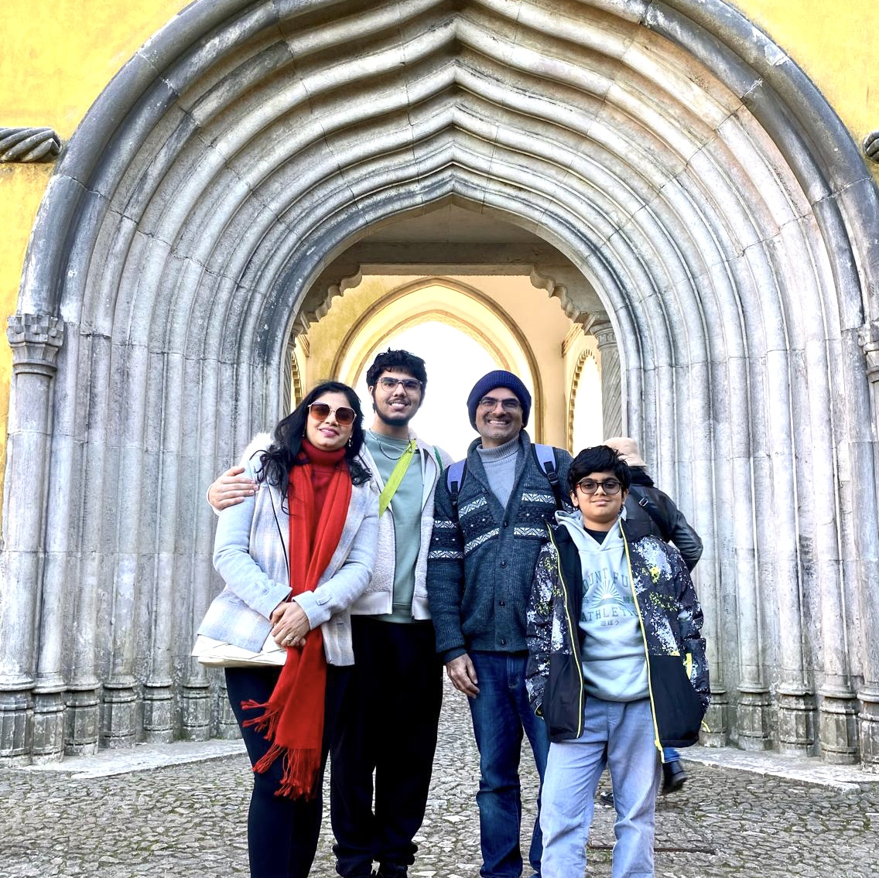
Getting to Know Me
Work
Personal
My role
HRBP RoW Regions/Sustainability/LCCS/IQFS
Significant others / family members / furry friends in my life
My wife and my two boys
Tenure in ofi/Olam
15
How I enjoy spending my free time
Tennis, reading defense news articles
Previous companies I have worked at
Microsoft
My favorite / comfort food
Chicken Tikka
Why I joined ofi/Olam and what keeps me here?
Opportunity to work in a global role
Richness and Independence provided with the roles
My favorite song
Afreen Afreen – Nusrat Fateh Ali Khan
Naveen Chhabra
‘Naveen’
A few fun facts about me
Have lived in 7 different cities/towns in India
This is me outside work, doing stuff I enjoy in my life …

